Slide 1
CSE 445 Lecture 9.1
Decision Tree Classification

Slide 2
Decision tree
Classification and regression trees are machine-learning methods for constructing prediction models from data
The models are obtained by recursively partitioning the data space and fitting a simple prediction model within each partition
As a result, the partitioning can be represented graphically as a decision tree
Classification trees are designed for dependent variables that take a finite number of unordered values, with prediction error measured in terms of mis-classification cost
Regression trees are for dependent variables that take continuous or ordered discrete values, with prediction error typically measured by the squared difference between the observed and predicted values

Slide 3
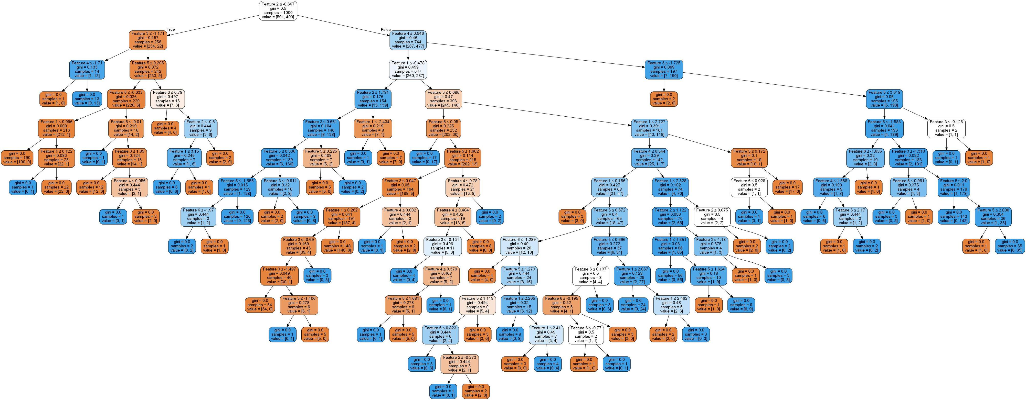
Decision Tree classifier

Slide 4
Decision tree
In a classification problem, we have a training sample of n observations on a class variable Y that takes values 1, 2, ... , k, and p predictor variables, X1,..., Xp
Our goal is to find a model for predicting the values of Y from new X values
In theory, the solution is simply a partition of the X space into k disjoint sets, A1, A2,..., Ak, such that:
The predicted value of Y is j if X belongs to Aj , for j = 1, 2,..., k

Slide 5
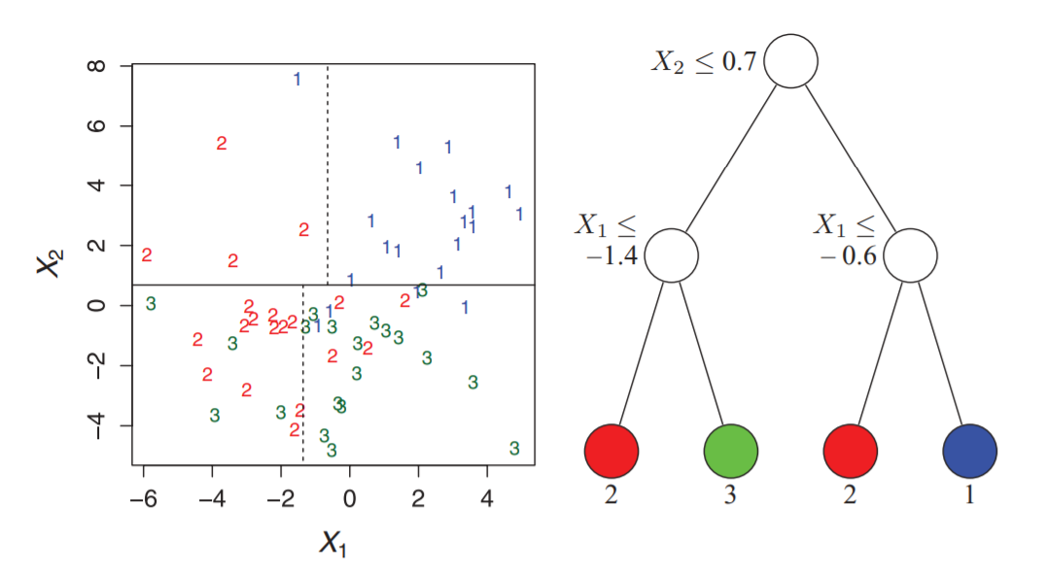
Decision tree example

Slide 6
Decision tree
We start at the root and split the data based on the features
We repeat this splitting procedure at each child node until the leaves are pure
This means that the training examples at each node all belong to the same class
In practice, this can result in a very deep tree with many nodes, which can easily lead to overfitting
We typically want to prune the tree by setting a limit for the maximal depth of the tree

Slide 7
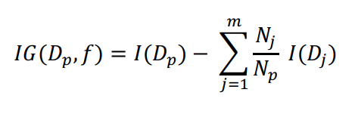

Cost function (Objective function)
The IG is simply the difference between the impurity of the parent node and the sum of the child node impurities
The lower the impurities of the child nodes, the larger the information gain
To keep the solution tractable, that is to reduce the combinatorial search space, most implementations use binary decision trees
In that case, the above IG formula transform to the following

Slide 8

Impurity measurement: Entropy
Here p(i|t) – the proportion of the examples that belong to class i for a particular node t
The entropy is 0 if all examples at a node belong to the same class
In a binary class setting, the entropy is 0 if 𝑝(𝑖 = 1|𝑡) = 1 or 𝑝(𝑖 = 0|𝑡) = 0
The entropy is maximal if we have uniform class distribution
If the classes are distributed uniformly with 𝑝(𝑖 = 1|𝑡) = 0.5 and 𝑝(𝑖 = 0|𝑡) = 0.5, the entropy is 1
Therefore, we can say that the entropy criterion attempts to maximize the mutual information in the tree

Slide 9


Impurity measurement: Gini impurity
It tries to minimize the probability of misclassification
Gini impurity is maximal if the classes have equal probabilities
For example, in a binary class setting
However in practice Gini impurity and entropy performs almost the same

Slide 10

Impurity measurement: Classification error
It looks promising
But it is manly used for pruning the tree
It is less sensitive to the class probabilities of the nodes

Slide 11
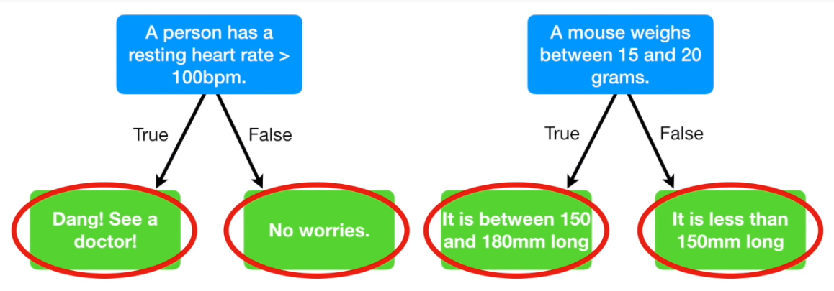
Building a Decision Tree

Slide 12
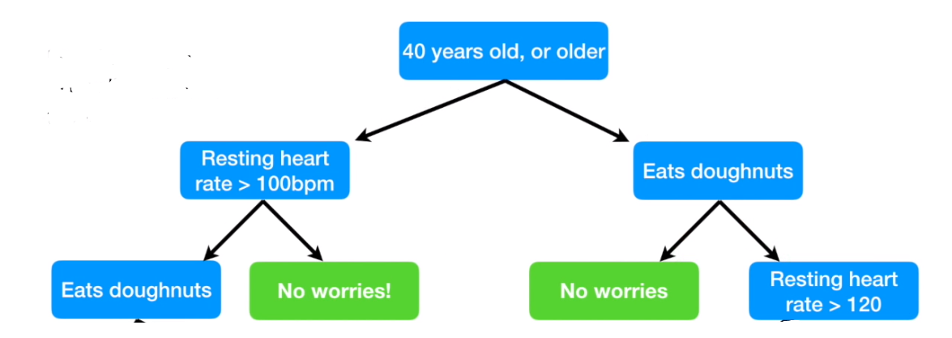
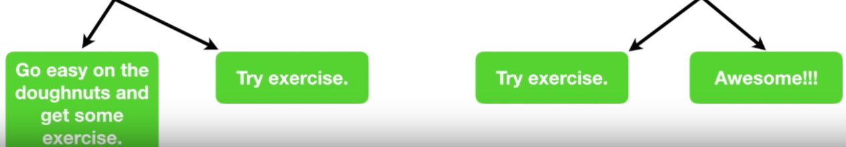
Building a Decision Tree

Slide 13
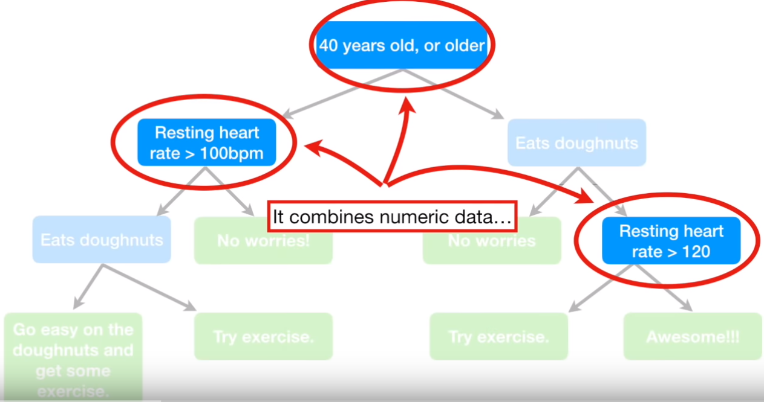
Building a Decision Tree

Slide 14
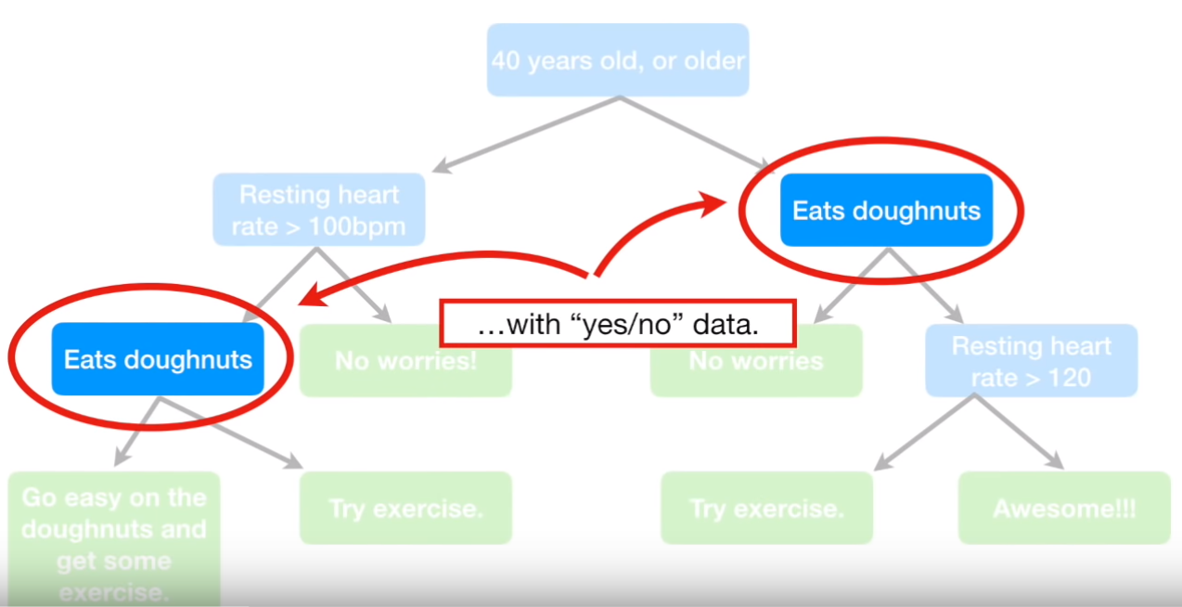
Building a Decision Tree

Slide 15
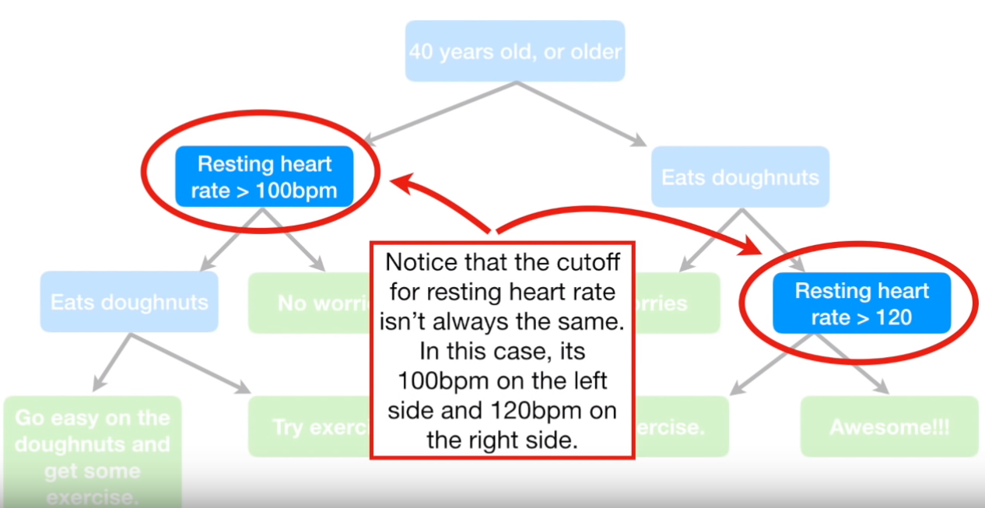
Building a Decision Tree

Slide 16
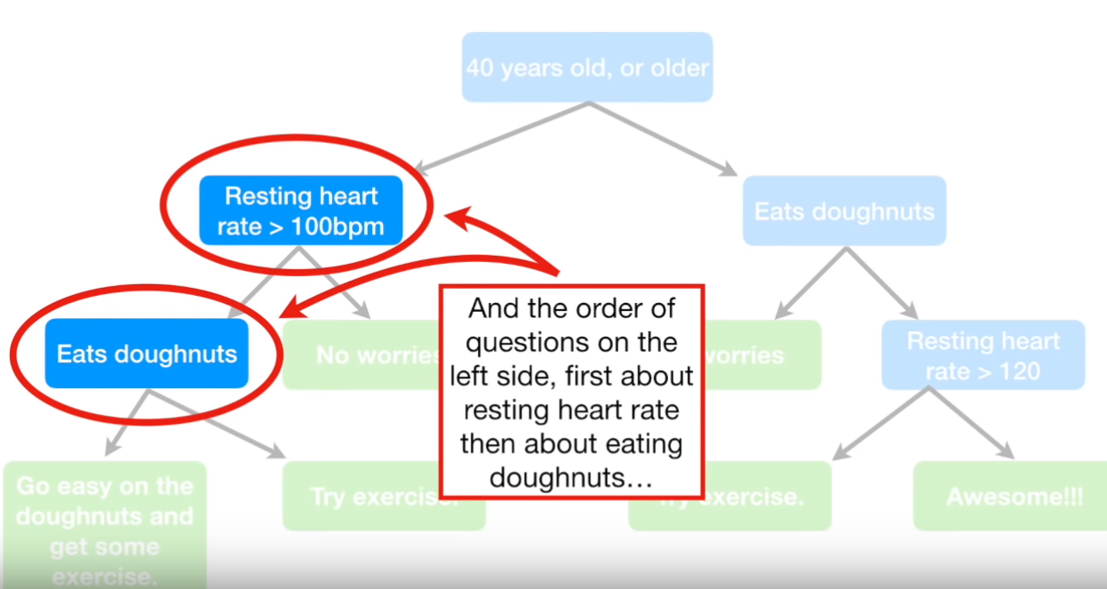
Building a Decision Tree

Slide 17
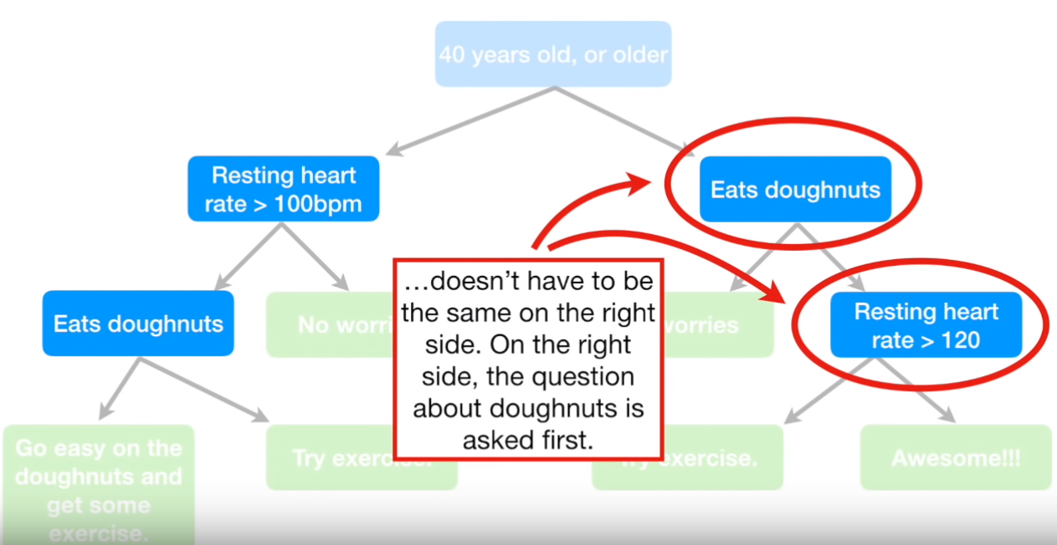
Building a Decision Tree

Slide 18
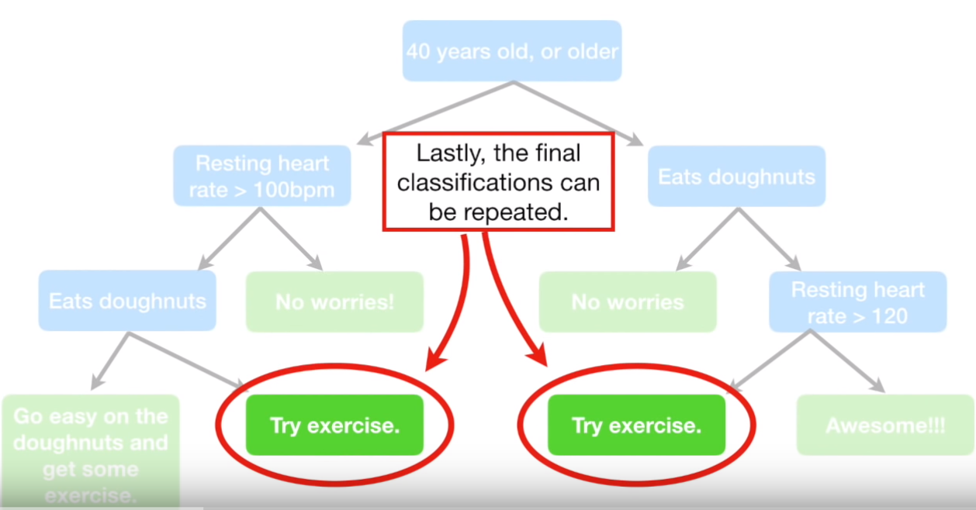
Building a Decision Tree

Slide 19
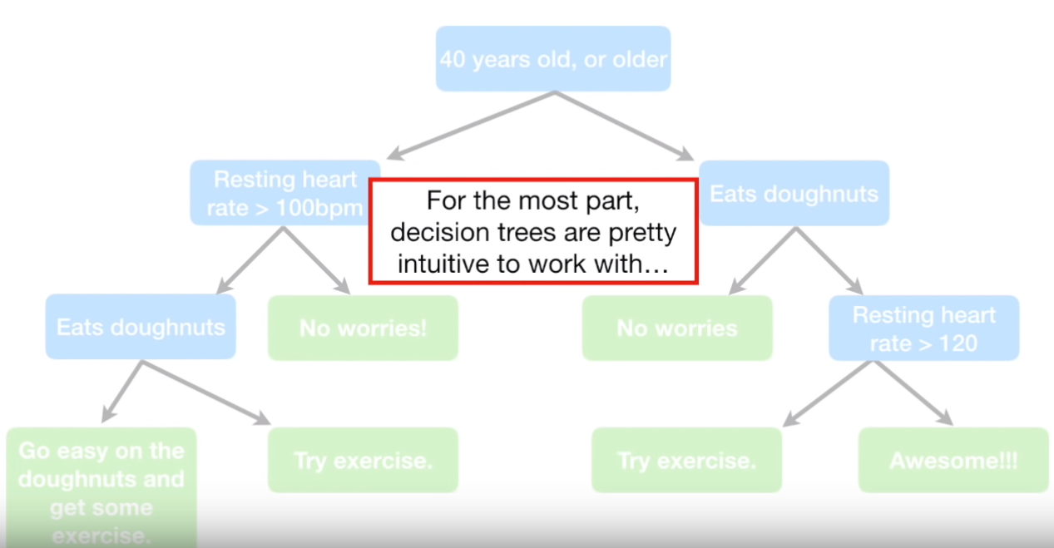
Building a Decision Tree

Slide 20
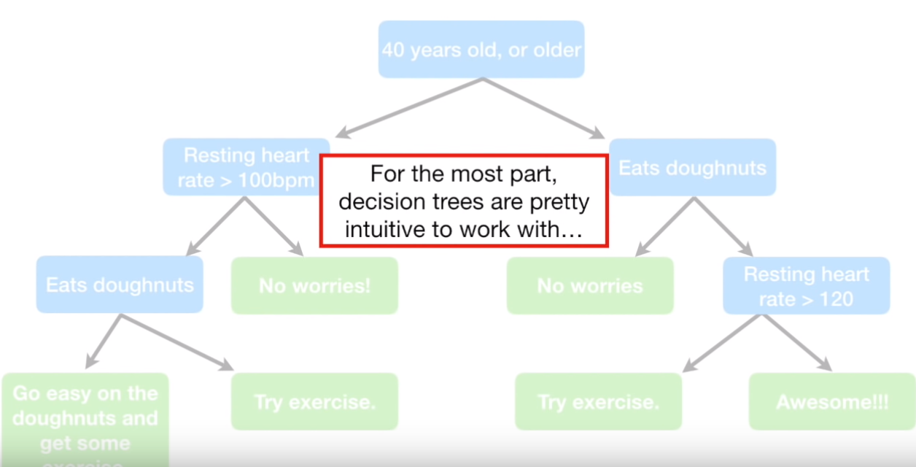
Building a Decision Tree

Slide 21
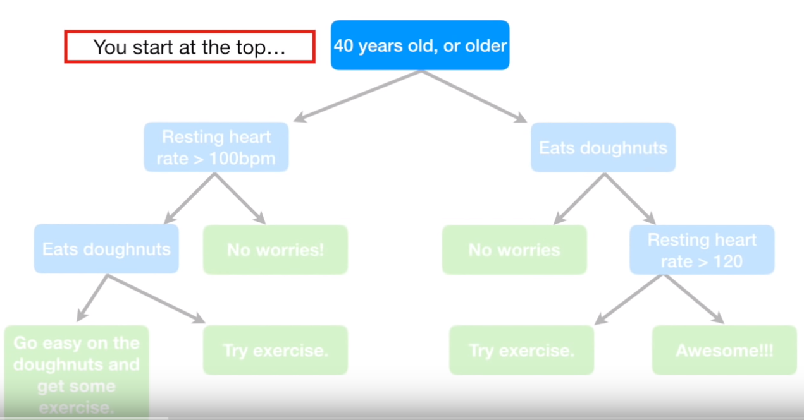
Building a Decision Tree

Slide 22
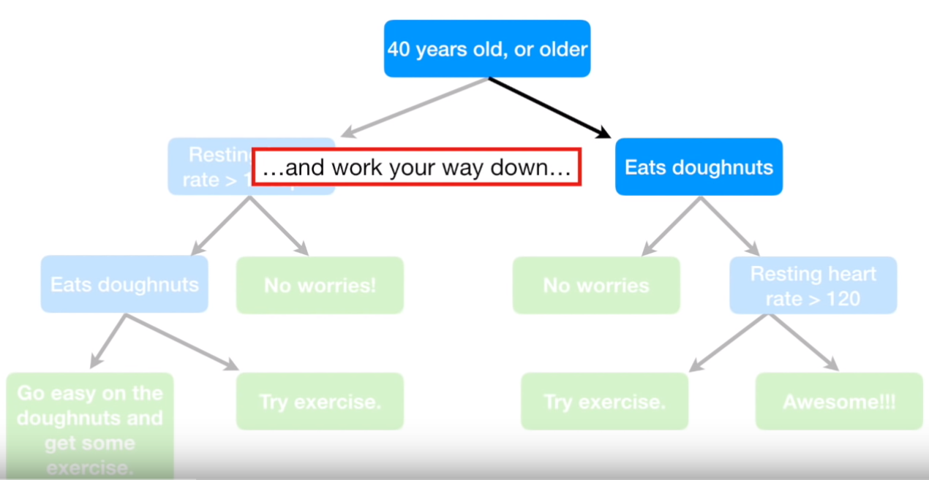
Building a Decision Tree

Slide 23
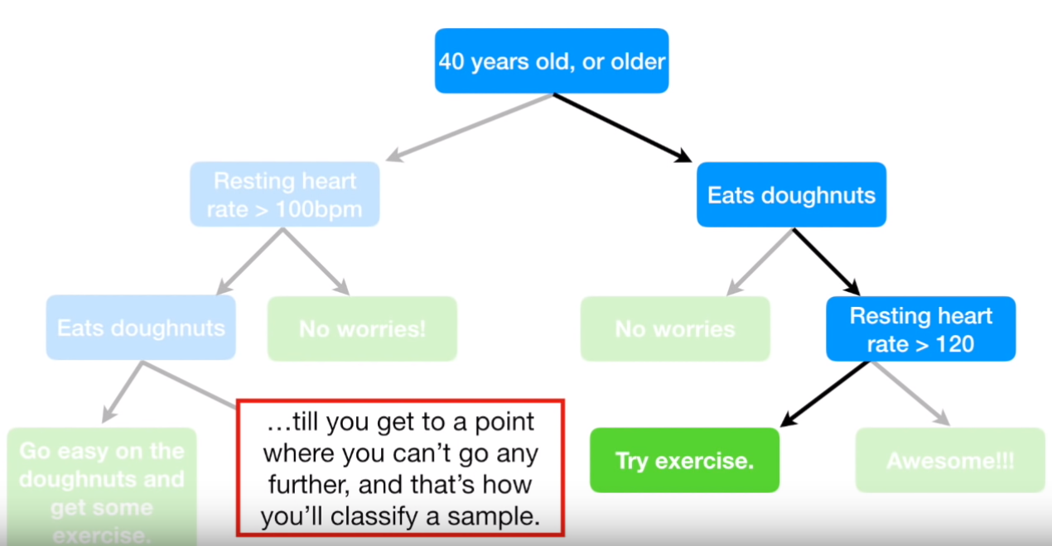
Building a Decision Tree

Slide 24
Simulation

Slide 25
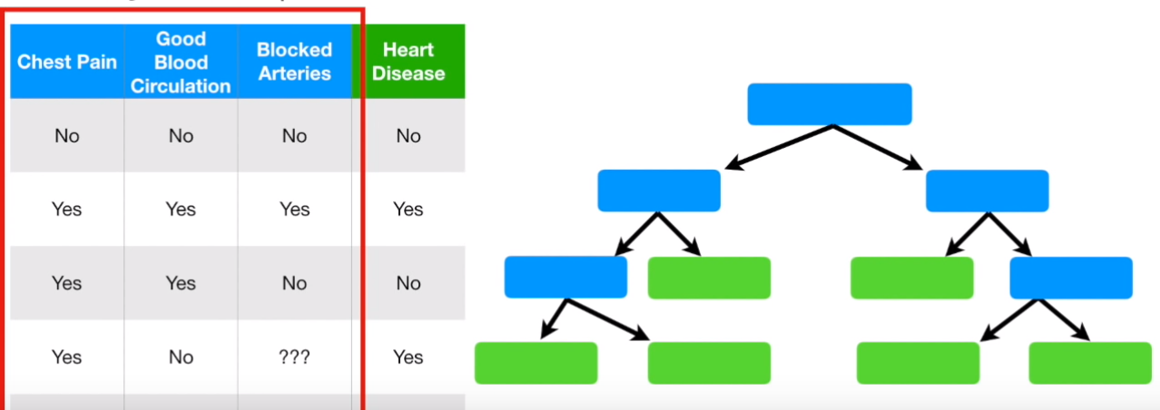
Building a Decision Tree

Slide 26
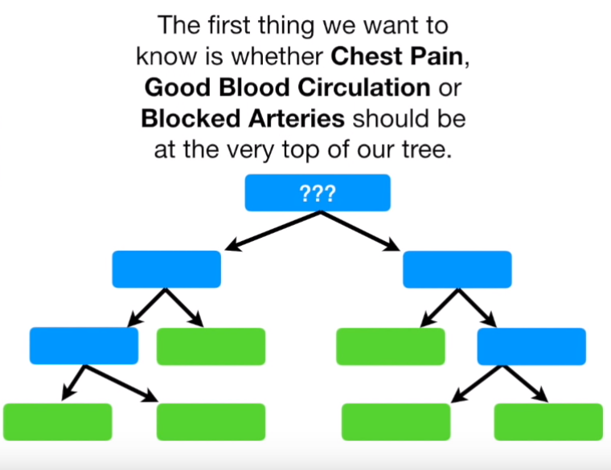
Building a Decision Tree

Slide 27
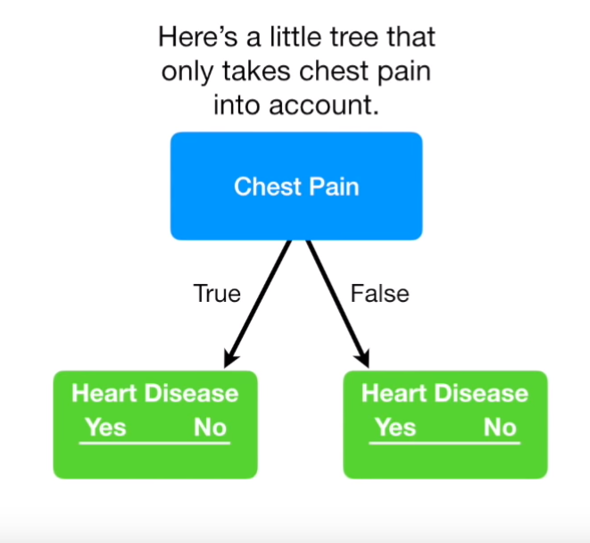
Building a Decision Tree

Slide 28
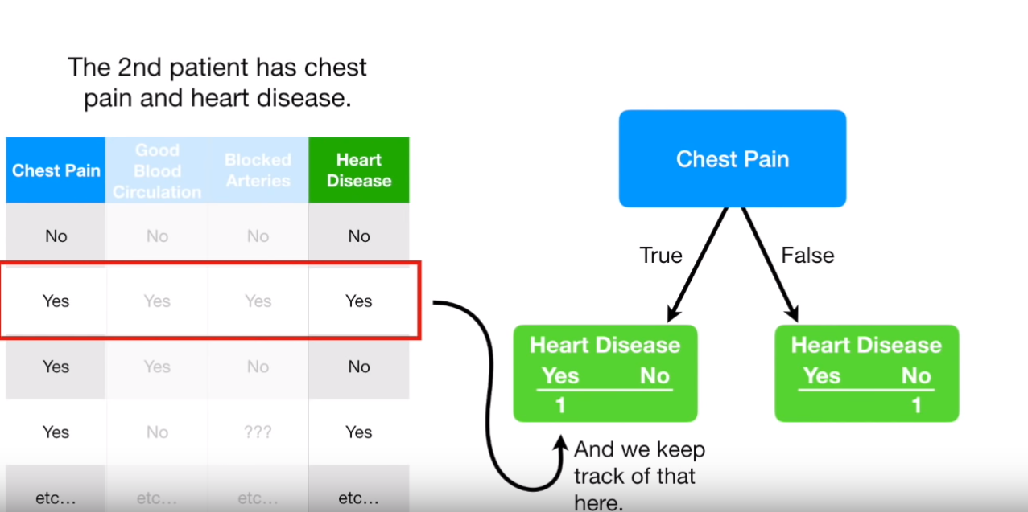
Building a Decision Tree

Slide 29
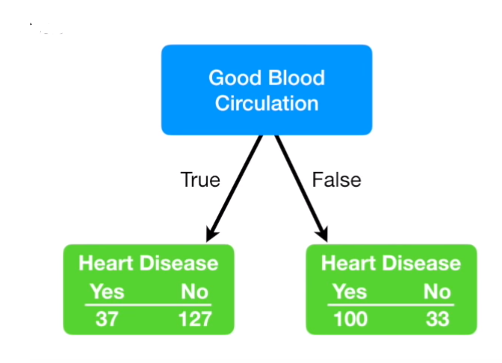
Building a Decision Tree

Slide 30
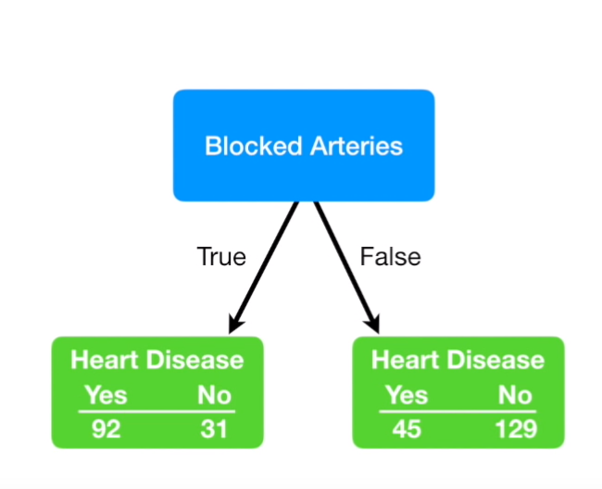
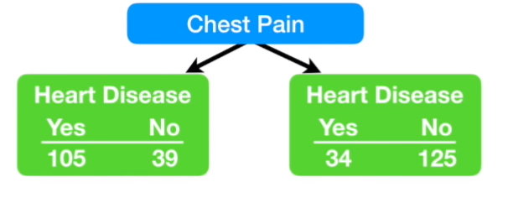
Building a Decision Tree

Slide 31
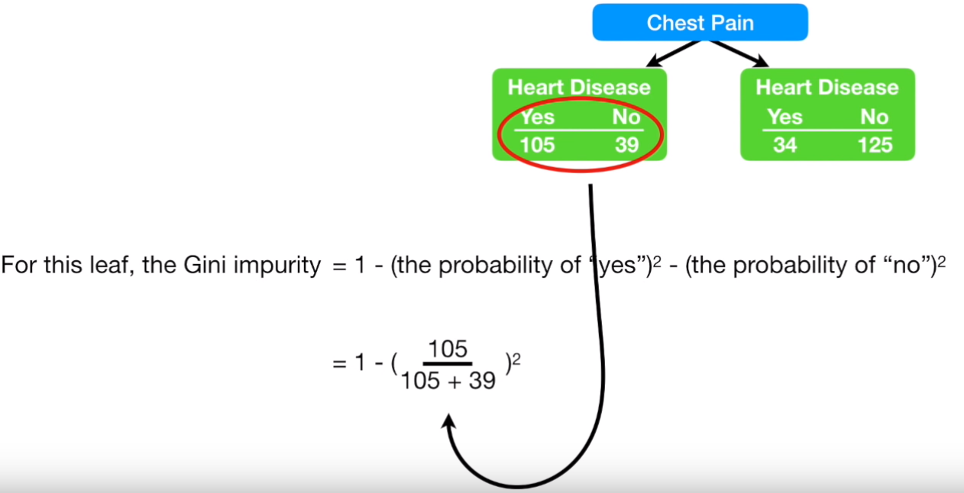
Building a Decision Tree

Slide 32
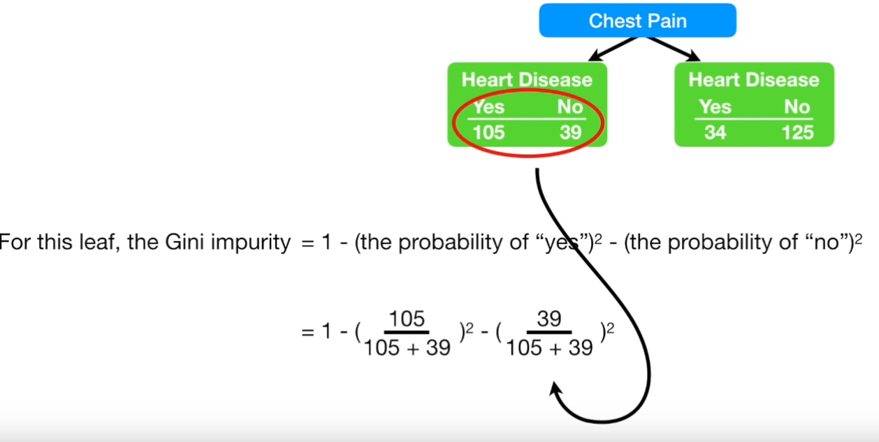
Building a Decision Tree

Slide 33
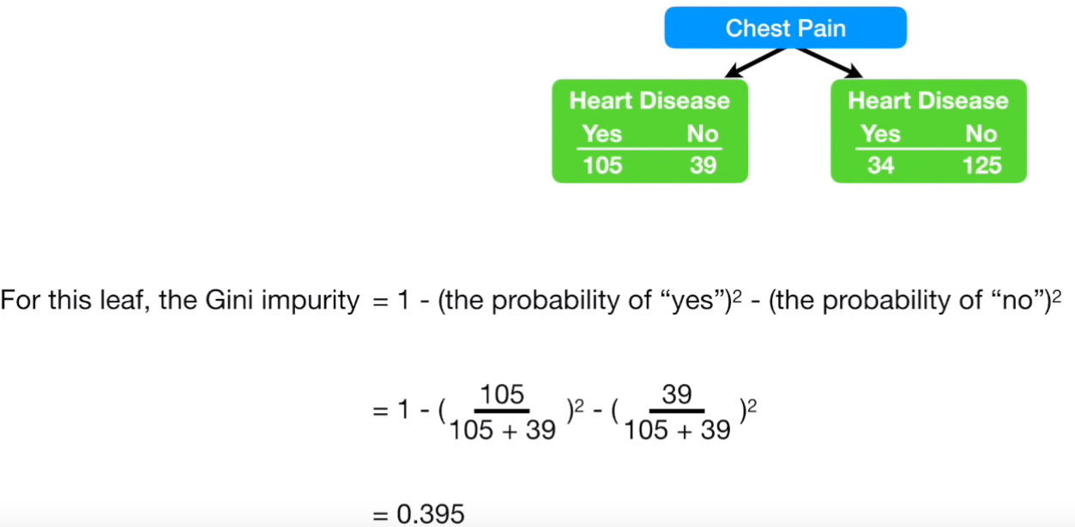
Building a Decision Tree

Slide 34
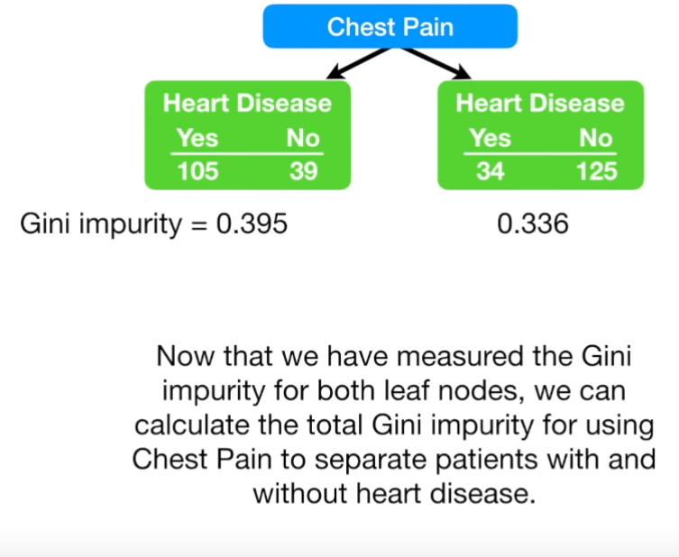
Building a Decision Tree

Slide 35
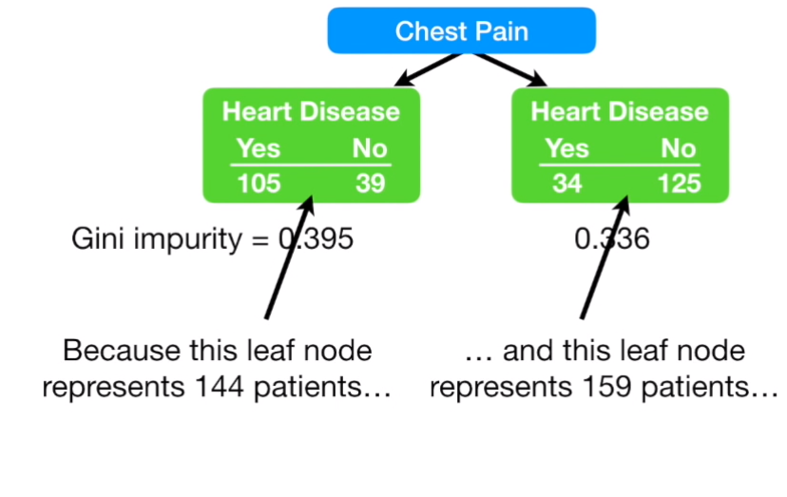
Building a Decision Tree

Slide 36
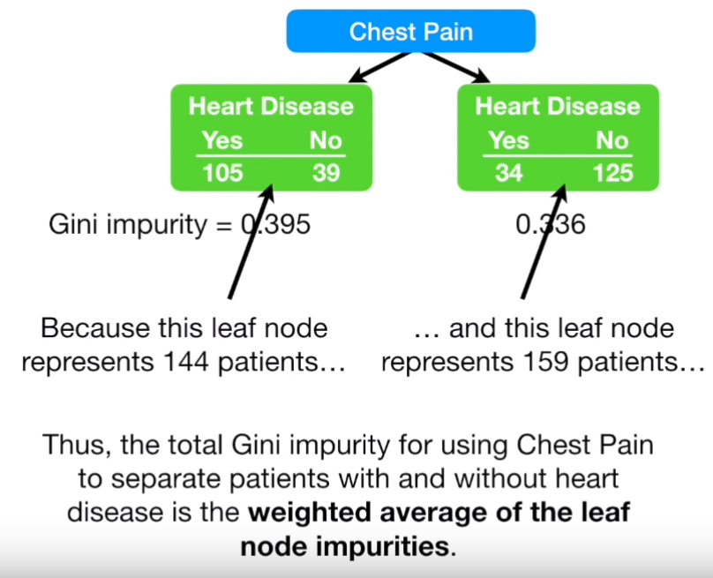
Building a Decision Tree

Slide 37
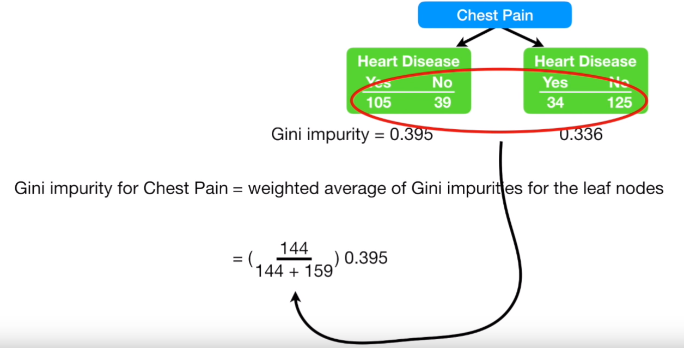
Building a Decision Tree

Slide 38
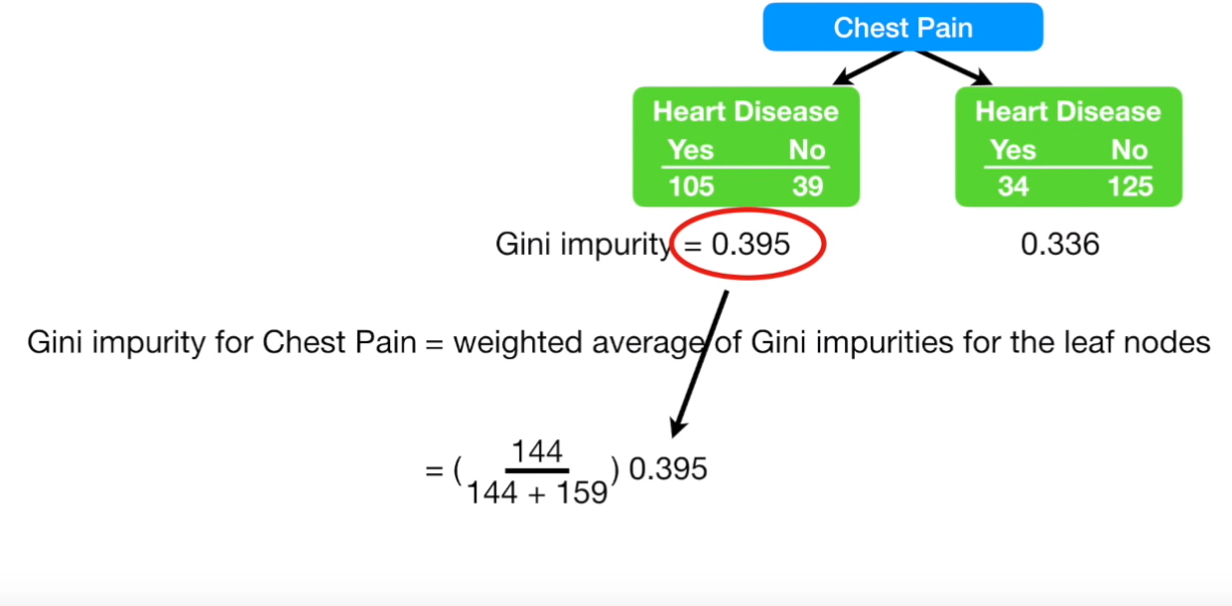
Building a Decision Tree

Slide 39
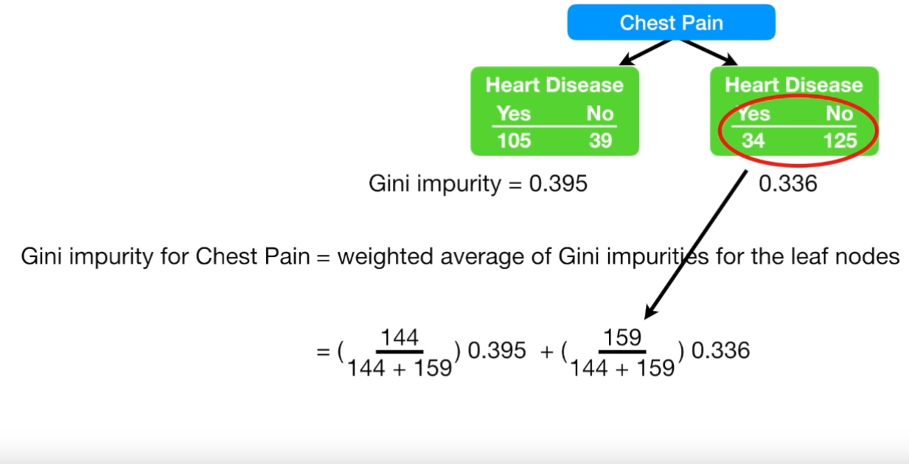
Building a Decision Tree

Slide 40
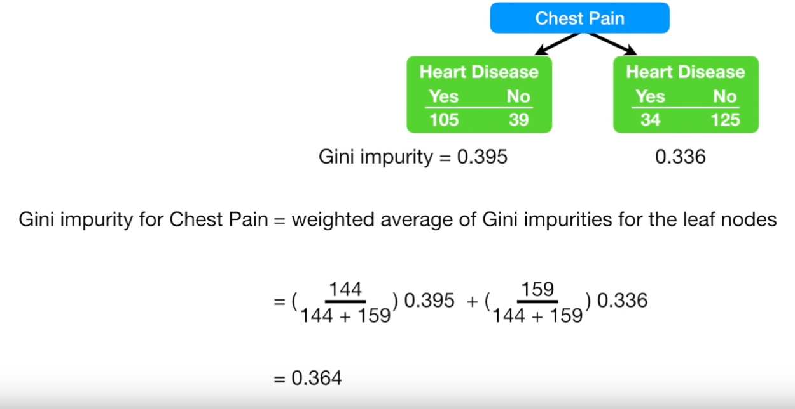
Building a Decision Tree

Slide 41
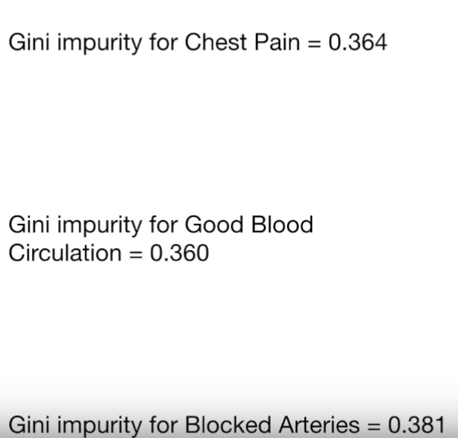
Building a Decision Tree

Slide 42
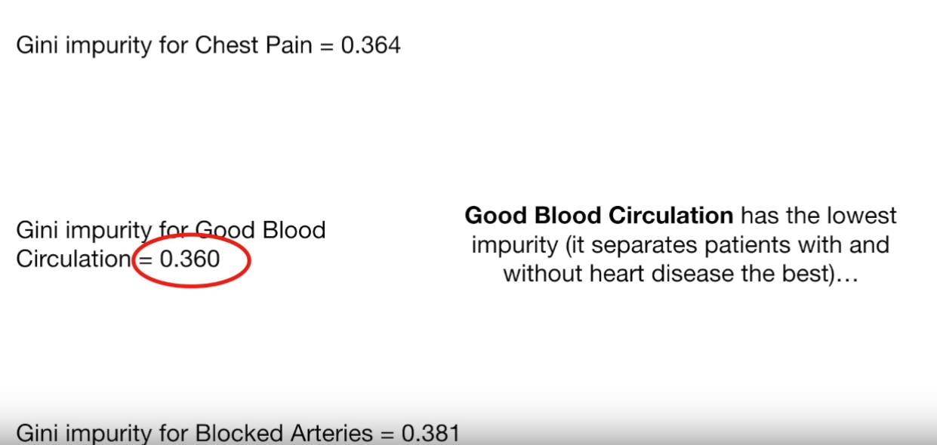
Building a Decision Tree

Slide 43
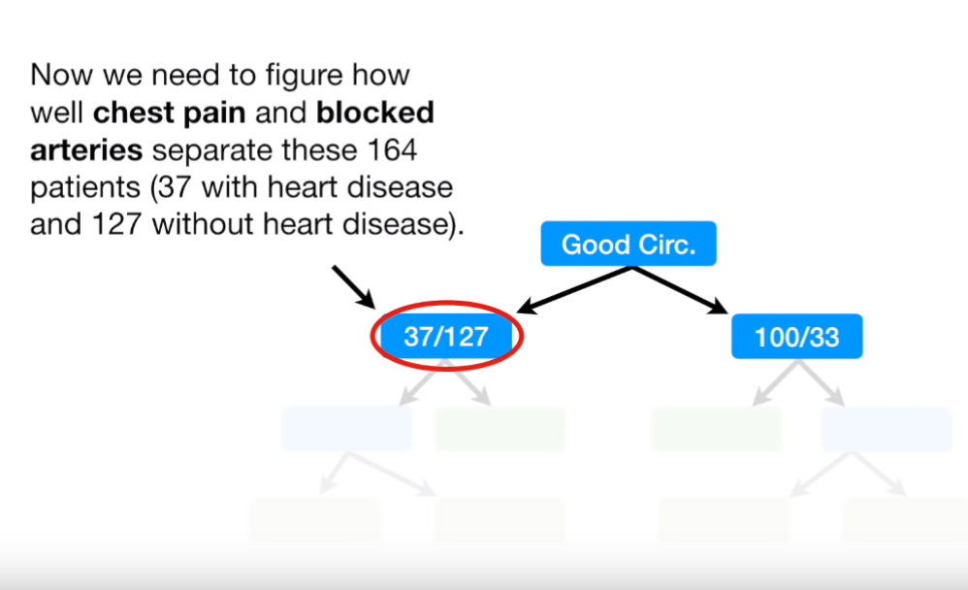
Building a Decision Tree

Slide 44
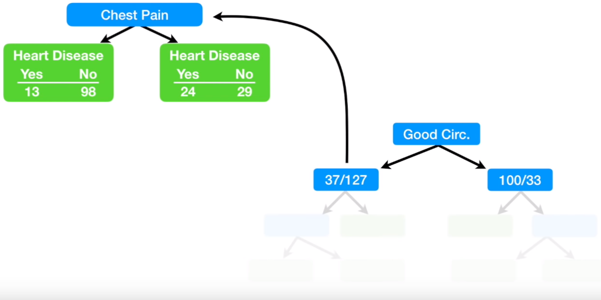
Building a Decision Tree

Slide 45
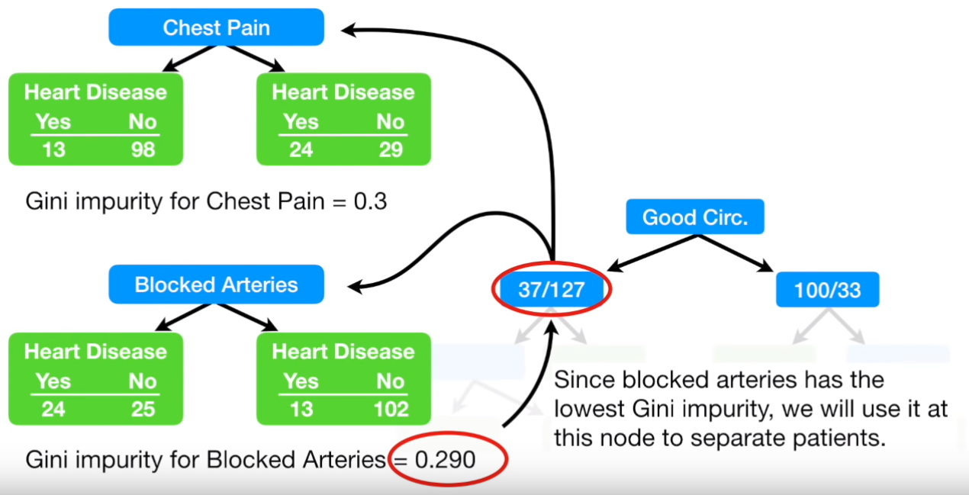
Building a Decision Tree

Slide 46
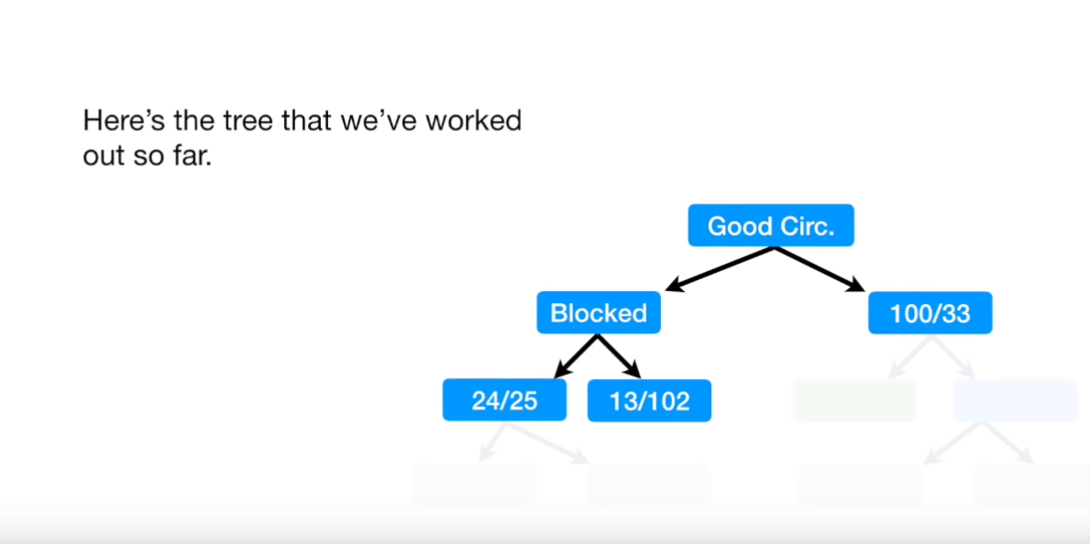
Building a Decision Tree

Slide 47
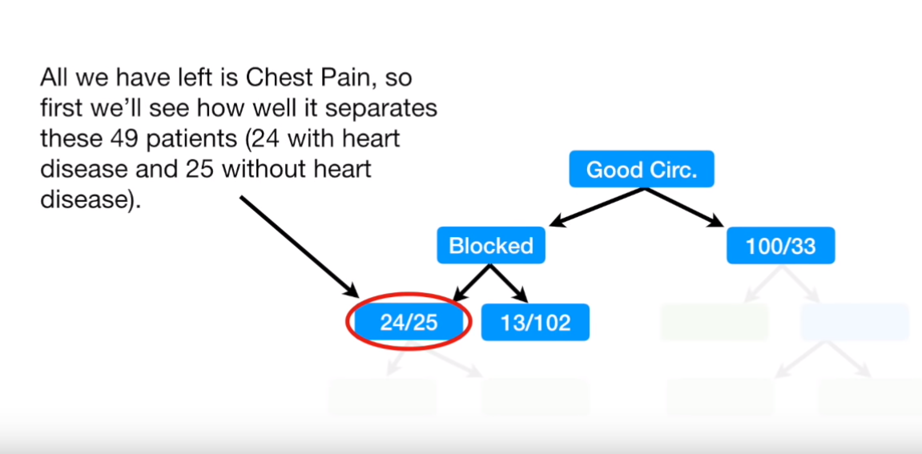
Building a Decision Tree

Slide 48
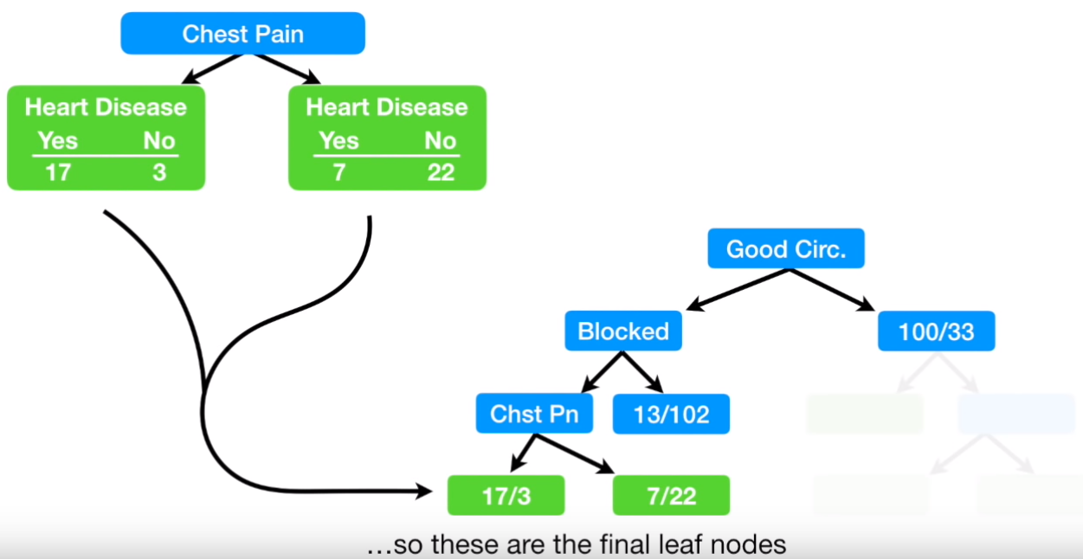
Building a Decision Tree

Slide 49
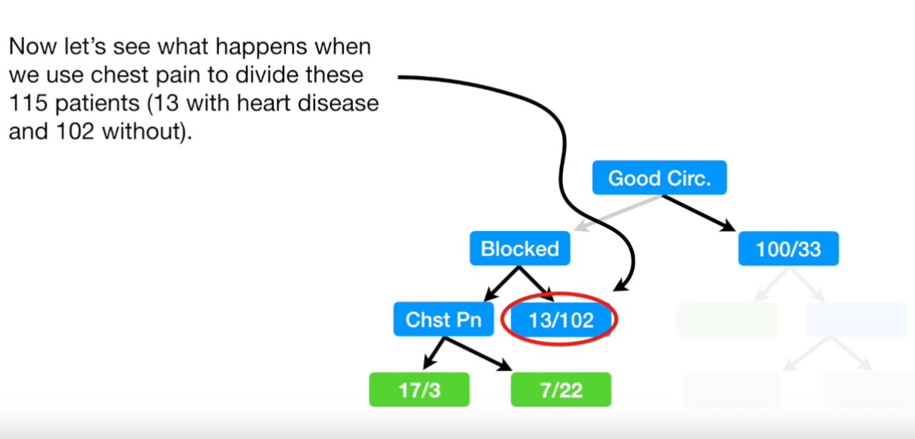
Building a Decision Tree

Slide 50
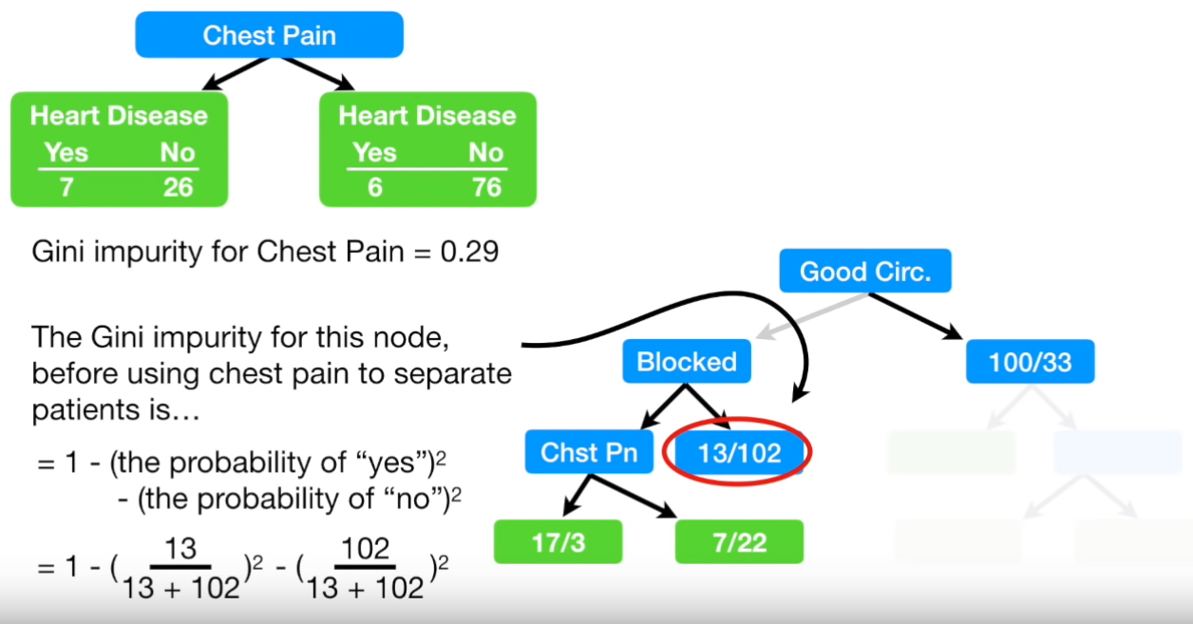
Building a Decision Tree
0.2

Slide 51
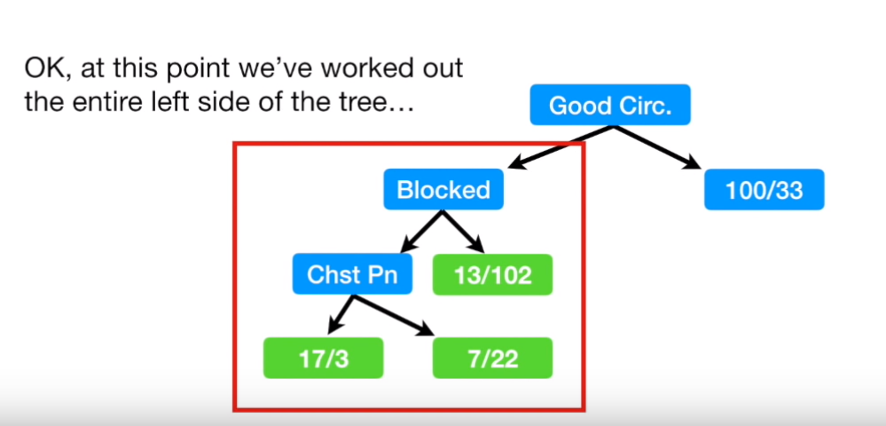
Building a Decision Tree

Slide 52
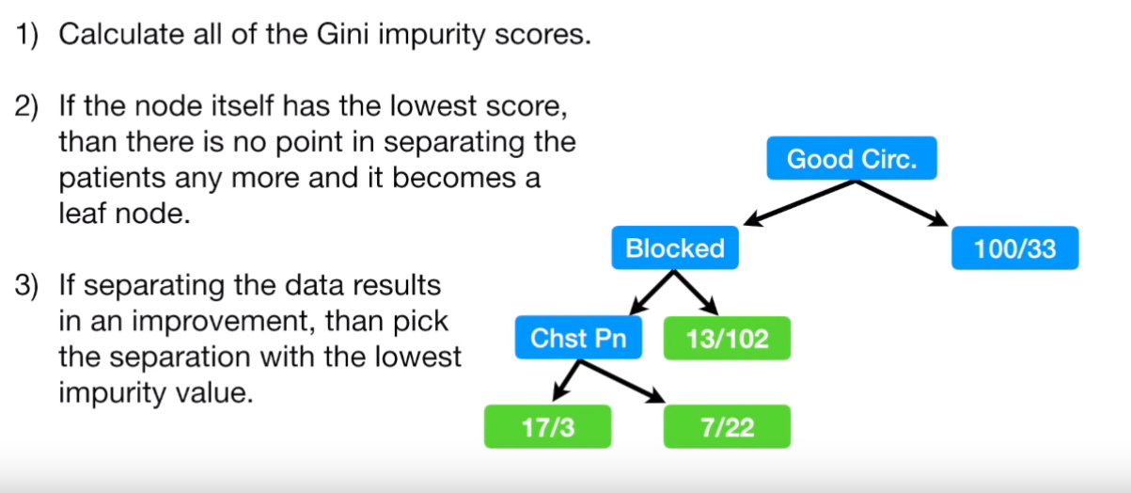
Building a Decision Tree

Slide 53
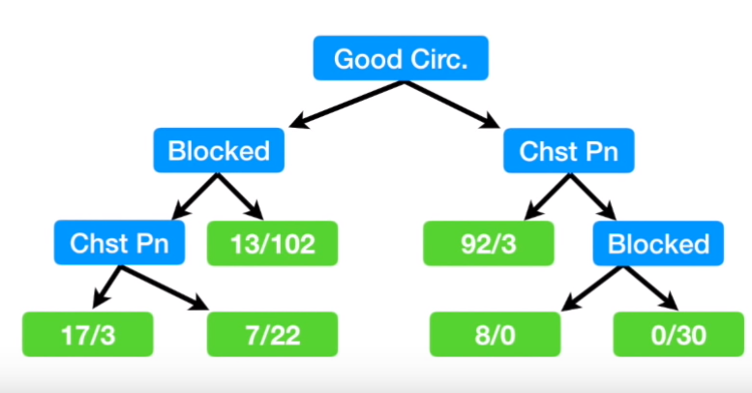
Building a Decision Tree

Slide 54
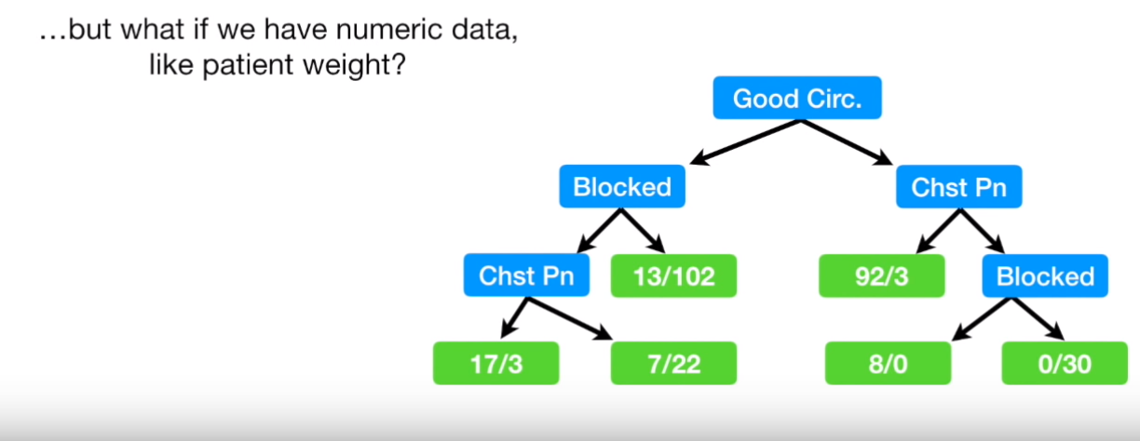
Building a Decision Tree

Slide 55
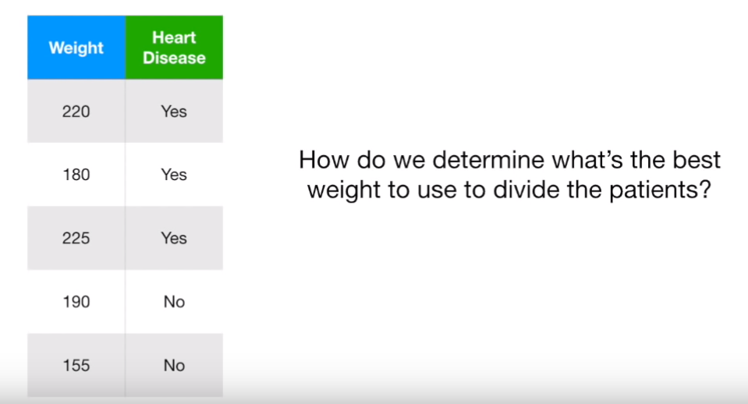
Building a Decision Tree

Slide 56
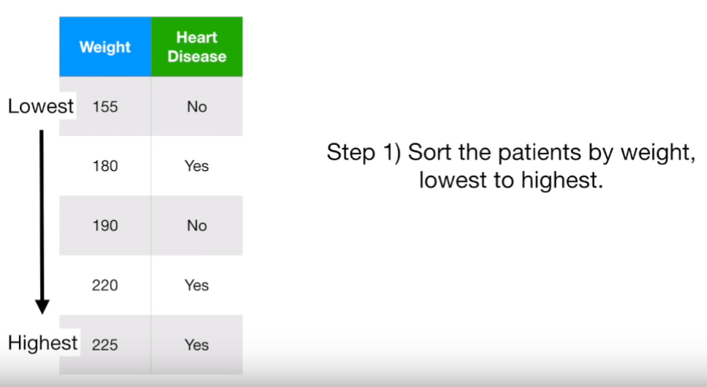
Building a Decision Tree

Slide 57







Building a Decision Tree

Slide 58



Building a Decision Tree

Slide 59


Building a Decision Tree

Slide 60

Building a Decision Tree

Slide 61



Building a Decision Tree

Slide 62



Building a Decision Tree

Slide 63



Building a Decision Tree

Slide 64












Building a Decision Tree

Slide 65

Building a Decision Tree

